Slide 1
Ikemiyagi Sekihô “Officer Ukuma” (1922)
池宮城籍宝
奥間巡査

Slide 2
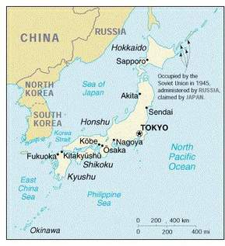
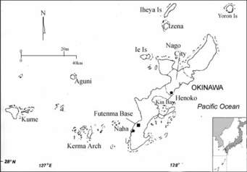
Maps

Slide 3
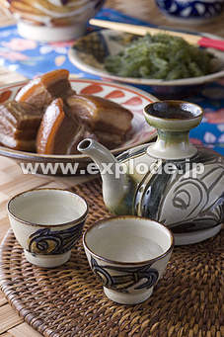
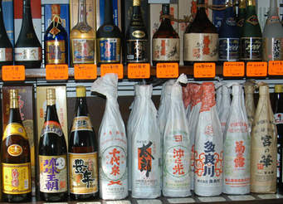
Awamori

Slide 4
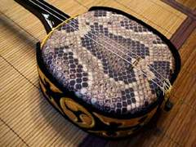
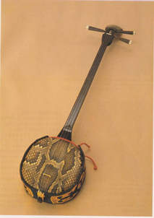
Jabisen

Slide 5
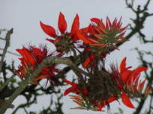
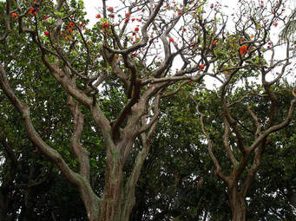
Deigo

Slide 6
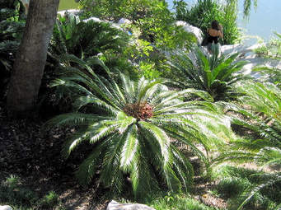
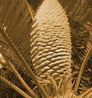
Sôtetsu Palm Hell

Slide 7
Keywords
Taishô period
Kume
Tsuji
Tombs
“Sôtetsu Palm Hell”
shaman
Hygiene
Kyûshû (Kagoshima, Saga, Miyazaki)
Language
Allegory
Subaltern
Rise and succeed (risshin shusse)

Slide 8
Recommended Reading
Alan Christy, “The Making of Imperial Subjects in Okinawa,” positions: east asia critique 1 (3): 607-638.

Slide 9
Discussion Questions
What do “Kunenbo Orange Trees” or “A Conversation” and “Officer Ukuma” have in common?
What can you point to that is modern in “Officer Ukuma”? What is traditional in the story?
What is the story’s central theme?
Analyze the concluding passage. In what ways is Ukuma described? Why might this be?
Notes:
Postal savings, police, hygiene/community policing, banking

